Slide 1

AI vs Human Text Classification Prepared BY: Mulualem Asmare
Picture source: https://hai.stanford.edu/news/human-writer-or-ai-scholars-build-detection-tool

Slide 2

Presentation Overview
Problem Definition
Problem Solution
Project Objective
Model Development Procedures
Result
Conclusion

Slide 3

Problem Definition
AI-generated text used for broadcasting false and inaccurate information is increasing, which will create:
Trustworthiness,
Security,
Privacy
Ethical issues
For example, according to The Washington Post, websites hosting AI-created false articles have increased by more than 1000 percent since May 2023.

Slide 4

Problem Solution
Develop and implement a text classification model trained on AI and human-generated text.

Slide 5

Project Objective
The objective of the project is recognizing the potential threat of AI-generated texts. It aims to develop and implement a robust text classification model capable of accurately distinguishing AI-generated and human-generated texts.

Slide 6

What is the Benefit of Doing this project ?
Having a model identifying the source of text, whether it is AI or human-generated, can allow the business to:
Identify fake news,
Promote security and privacy,
Uphold ethical values,
Increase productivity and efficiency,
Increase trustworthiness
Minimize potential risks.

Slide 7

Model Development Procedures
Data Collection
Data Preprocessing
Model Selection
Model Training and Testing
Model Evaluation
Hyperparameter tuning

Slide 8

Data Collection
Three datasets collected from Kaggle and Hugging Face.
The idea here is to create a large dataset to for training and testing for our classification model.
Appropriate methods are implemented to make smooth joining of the dataset into one large dataset.

Slide 9
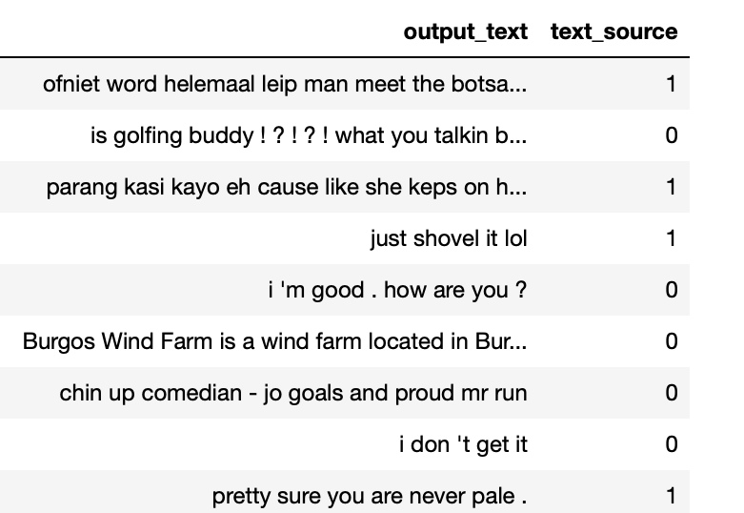
Data Collection
Unified data contains two features and more than 7 million rows.
The first feature contains text data generated by both AI and humans.
The second column contains labels to indicate whether the text was generated by AI or by a human.
The unified data is reduced to 400,000 rows. This is done to reduce computational load.

Slide 10

Data Preprocessing
Data cleaning , removal of stop words, special characters are performed.
These steps are crucial for developing a model that is less biased.

Slide 11
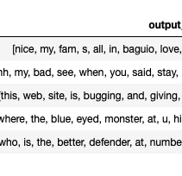
Data Preprocessing
The tokenization process is used in the project to:
Facilitate text cleaning
Extract meaningful information
Be able to create Term Frequency-Inverse Document Frequency.
Lemmatization is also used
To change words into their root form to allow the model to distinguish patterns.
It is also used for reducing dimensionality.

Slide 12
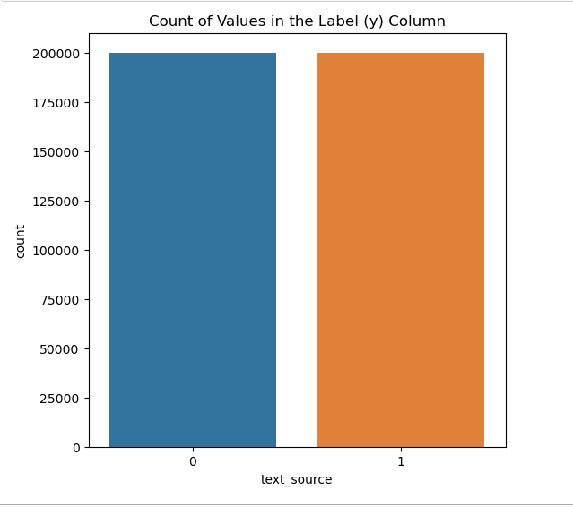
Data Preprocessing
Class balance check is performed on the target column, as class imbalance can lead to the development of a biased model.

Slide 13

Data Preprocessing
The preprocessed data undergoes vectorization using TF-IDF.
What are the reasons for choosing TF-IDF?
Considers both the frequency and uniqueness of words: Our Exploratory Data Analysis shows that most of the words in the top 15 in AI-generated text are also present in human-generated text but with different frequencies.
Since Random Forest is one of the models, employing such a vectorization method can prevent the creation of a high-dimensional space, which would lead to a heavy computational load and bias in our model.

Slide 14

Model Selection
Three supervised models are selected and compared for binary class classification :
Logistic Regression
Bernoulli Naïve Bayes
Random Forest Classifier
The choice of these three models is based on their differences in simplicity and their approach to processing data.

Slide 15

Model Training and Testing
Two sets of models are created
Row Text Data Models
Truncated Text Data Models
Reasons for creating two sets of models:
Truncated Text Data Models address biased models caused by significant differences in text length (mix of long and short text)
Random Forest model reveals a notable difference in training and test accuracy, suggesting potential overfitting..

Slide 16

Models Evaluation
Given a balanced class dataset, accuracy serves as the primary metric for evaluation.
In addition to accuracy, the evaluation incorporates:
Confusion Matrix: Provides a detailed breakdown of true positive, true negative, false positive, and false negative predictions.
Classification Report: Provides a detailed breakdown of precision, recall, F1, and accuracy of the model.

Slide 17
Hyperparameter Tuning
In model evaluation, since the Random Forest Classifier on the untruncated data produces a higher accuracy rate, this model is used for hyperparameter tuning to achieve the best accuracy rate using cross-validation grid search
After hyperparameter tuning the model accuracy is improved from 66% to 67 % which is the best among the three chosen models .

Slide 18

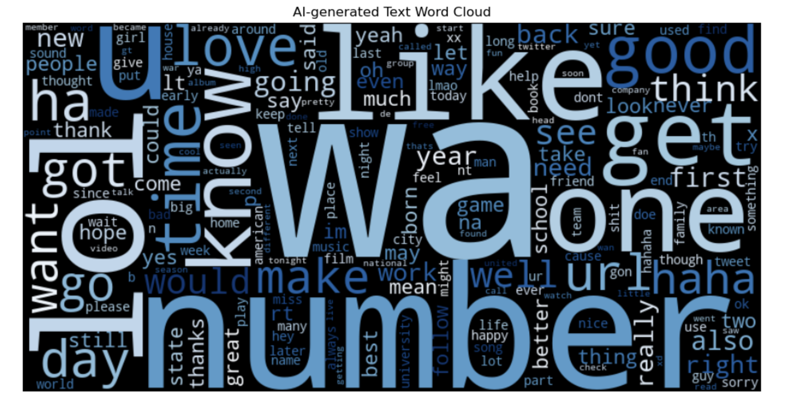
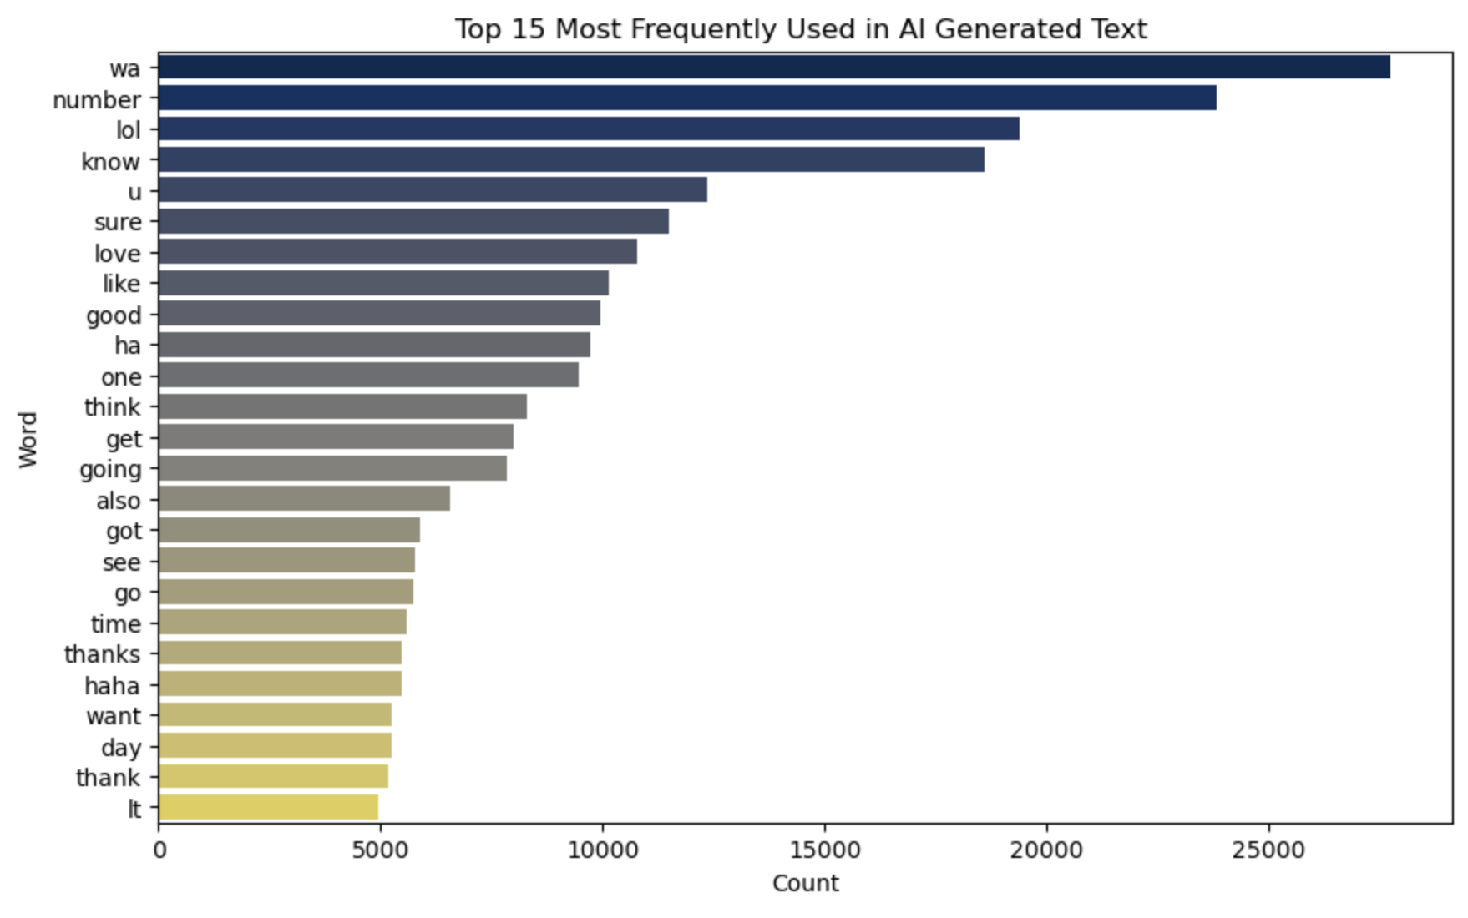
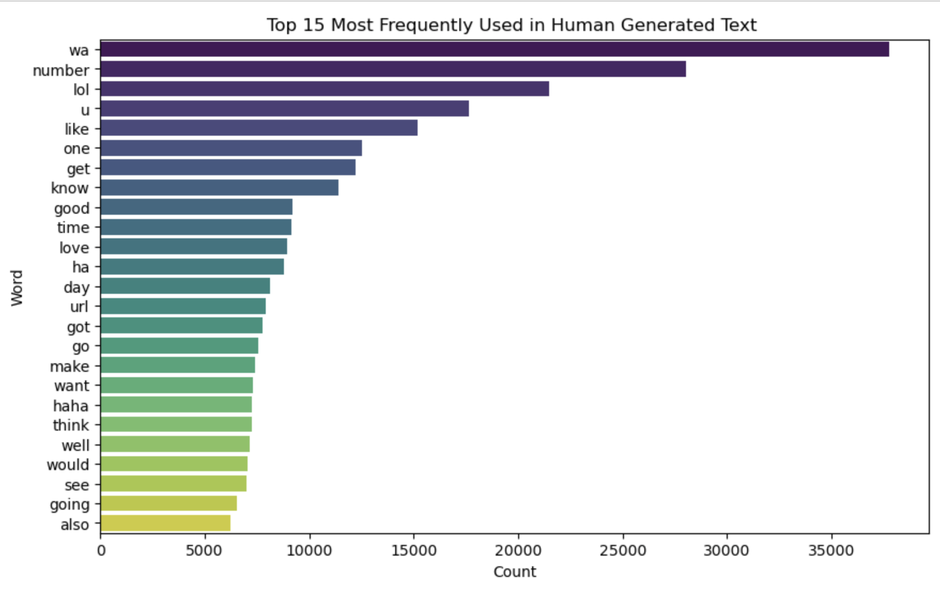
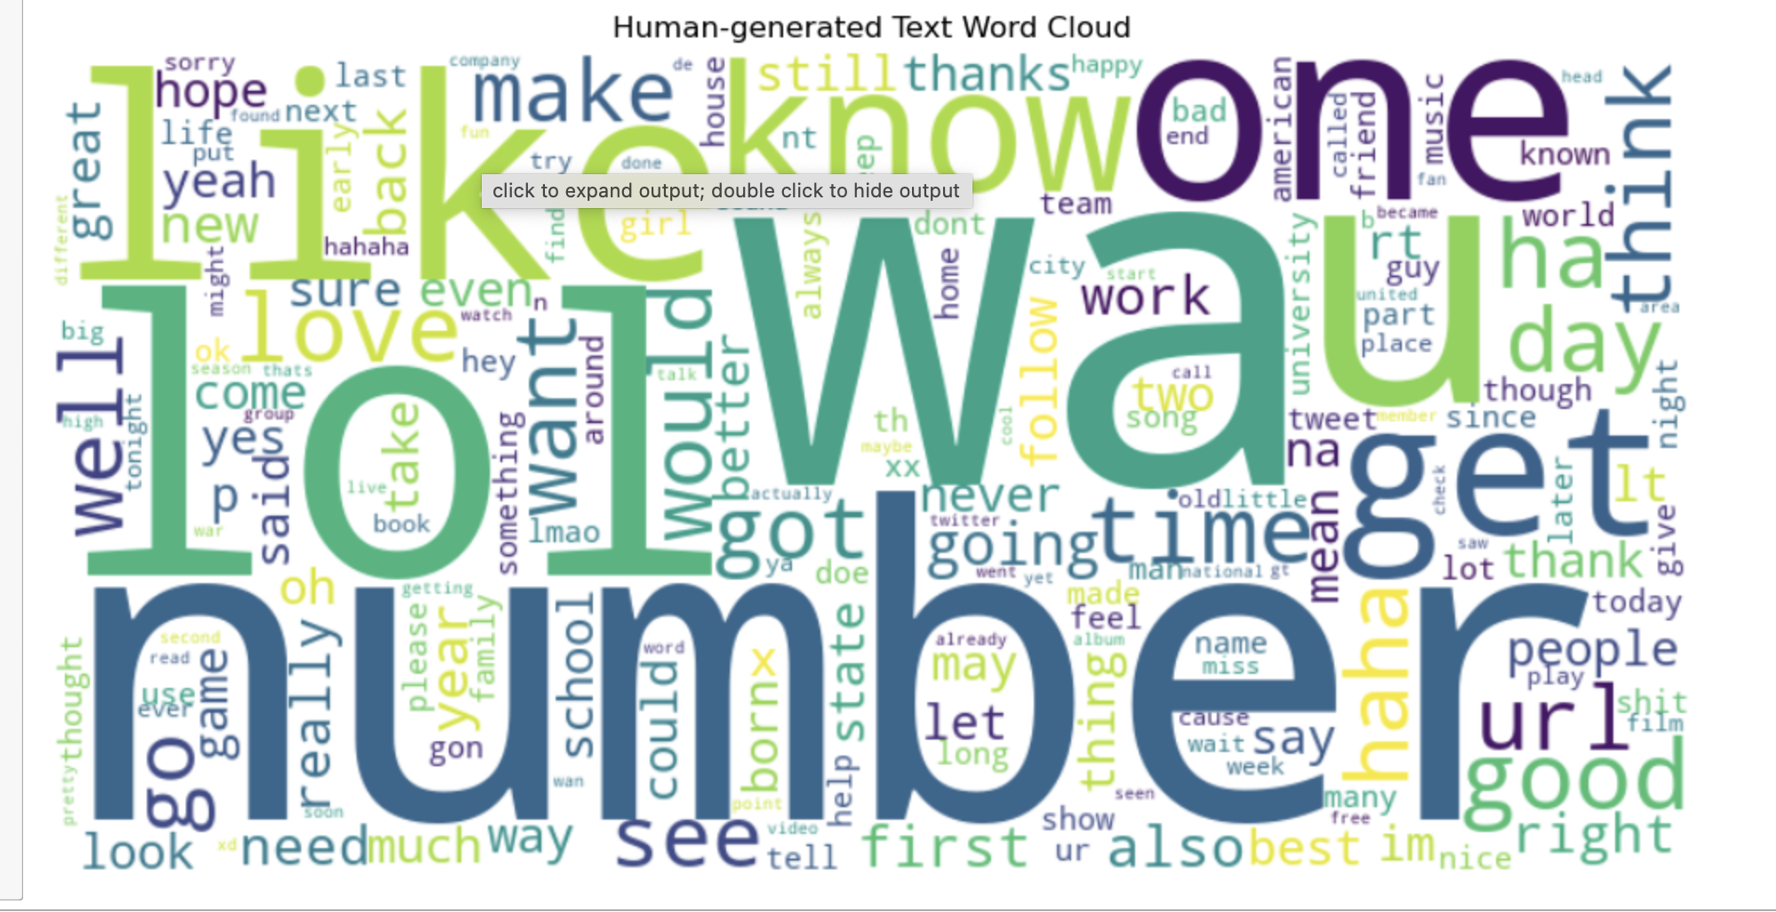
Exploratory Data Analysis Results

Slide 19
Comparisons of Models Using Untruncated Text Data.
 | Logistics Regression | Bernoulli Naïve Bayes | GridSearchCV Random Forest Classifier | Random Forest Classifier
Training Accuracy | 69% | 61% | 95% | 95%
Testing Accuracy | 63% | 57% | 67% | 66%
True Positive | 26923 | 13107 | 32337 | 31678
True Negative | 23224 | 32304 | 20909 | 21371
Precision text generated by AI (0) | 0.64 | 0.55 | 0.73 | 0.72
Precision text generated by human(1) | 0.61 | 0.63 | 0.63 | 0.63
Recall class 0 | 0.58 | 0.81 | 0.52 | 0.53
Recall class 1 | 0.67 | 0.33 | 0.81 | 0.79
F1 score class 0 | 0.61 | 0.65 | 0.61 | 0.61
F1 score class 1 | 0.64 | 0.43 | 0.70 | 0.70

Slide 20
Comparisons of Models Using Truncated Text Data
 | Logistics Regression | Bernoulli Naïve Bayes | Random Forest Classifier
Training Accuracy | 70% | 68% | 95%
Testing Accuracy | 63% | 61% | 65%
True Positive | 27866 | 21561 | 31265
True Negative | 22744 | 27366 | 21035
Precision text generated by AI (0) | 0.65 | 0.60 | 0.71
Precision text generated by human(1) | 0.62 | 0.63 | 0.62
Recall class 0 | 0.57 | 0.68 | 0.52
Recall class 1 | 0.70 | 0.54 | 0.78
F1 score class 0 | 0.61 | 0.64 | 0.60
F1 score class 1 | 0.65 | 0.58 | 0.69

Slide 21
Conclusion
Developing classification models that can distinguish between texts generated by AI and those created by humans is crucial. This effort not only helps combat misinformation but also plays a vital role in enhancing security, privacy, and risk mitigation.
For improving the accuracy of the classification model, using more data to train the model is advisable.
Trying other algorithms, such as deep neural networks, is also recommended.

Slide 22

References
How ai fake news is creating a ‘misinformation superspreader’ ... (n.d.). https://www.washingtonpost.com/technology/2023/12/17/ai-fake-news-misinformation/

Slide 23


